Slide 1
"Field Line" Search Revisited
Felix Meier

Slide 2
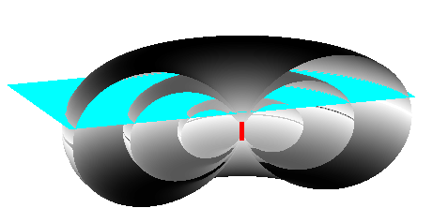
The Shape of the Dipole Field
Vertical Transmitter Antenna

Slide 3
The Shape of the Dipole Field
Horizontal Transmitter Antenna

Slide 4
Antenna Axis and Magnetic Field
Maximum Signal
No Signal

Slide 5
Projection
Signal
1.0
ϑ
ϑ
0°
30°
60°
90°

Slide 6
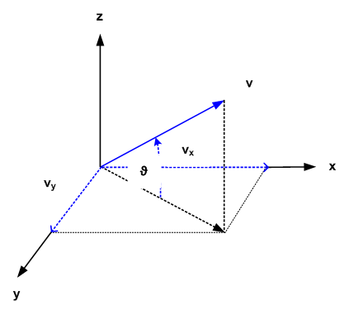
Projection

Slide 7
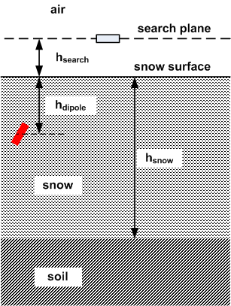
Layer Model

Slide 8
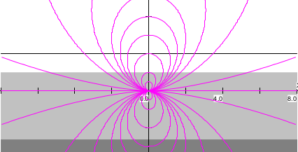
H Field Profile
Horizontal Transmitter Antenna

Slide 9
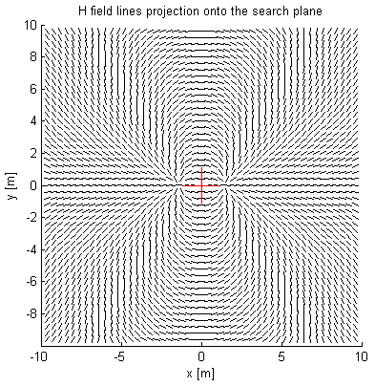
Projection of H Field onto the Search Plane
Horizontal Transmitter Antenna

Slide 10
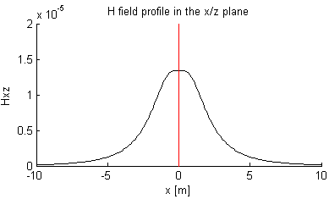
H Field Profile in the x/z Plane
Horizontal Transmitter Antenna

Slide 11
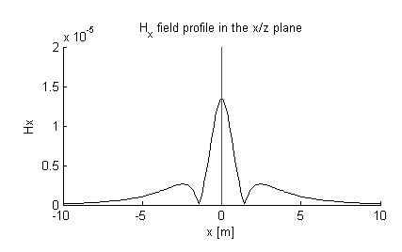
H Field Profile in the x/z Plane
No Z Antenna
Horizontal Transmitter Antenna

Slide 12
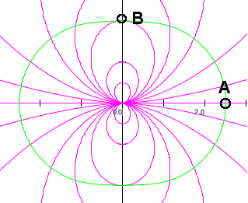
Distance Indication
Horizontal Transmitter Antenna

Slide 13
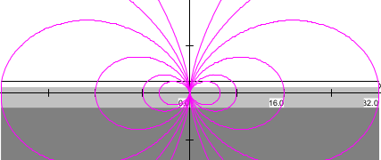
H Field Profile
Vertical Transmitter Antenna

Slide 14
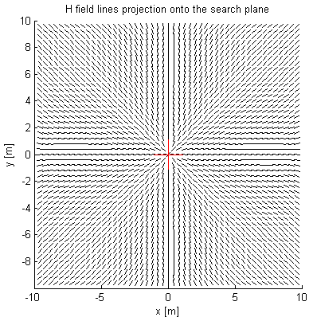
Projection of H Field onto the Search Plane
Vertical Transmitter Antenna

Slide 15
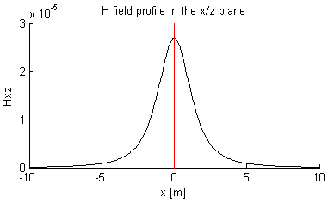
H Field Profile in the x/z Plane
Vertical Transmitter Antenna

Slide 16
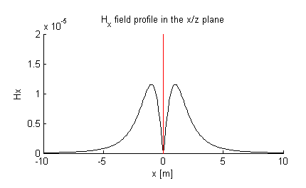
H Field Profile in the x/z Plane
No Z Antenna
Vertical Transmitter Antenna

Slide 17
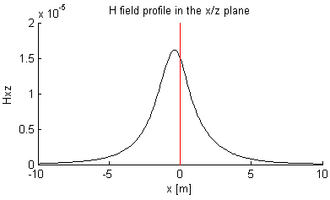
H Field Profile in the x/z Plane
30° Inclined Transmitter Antenna

Slide 18
Thank you for your attention !

